Slide 1



An approach in AI to Gomoku game
Nguyen Khanh Linh
Nguyen Thu Hieu
Nguyen Minh Tuan
Bui Tran Hai Quan
Le Duc Huy

Slide 2

Contents
Introduction to Gomoku Game
Development approach
Algorithms
Heuristics
Minimax
Alpha-Beta
Functionalities
Demo

Slide 3
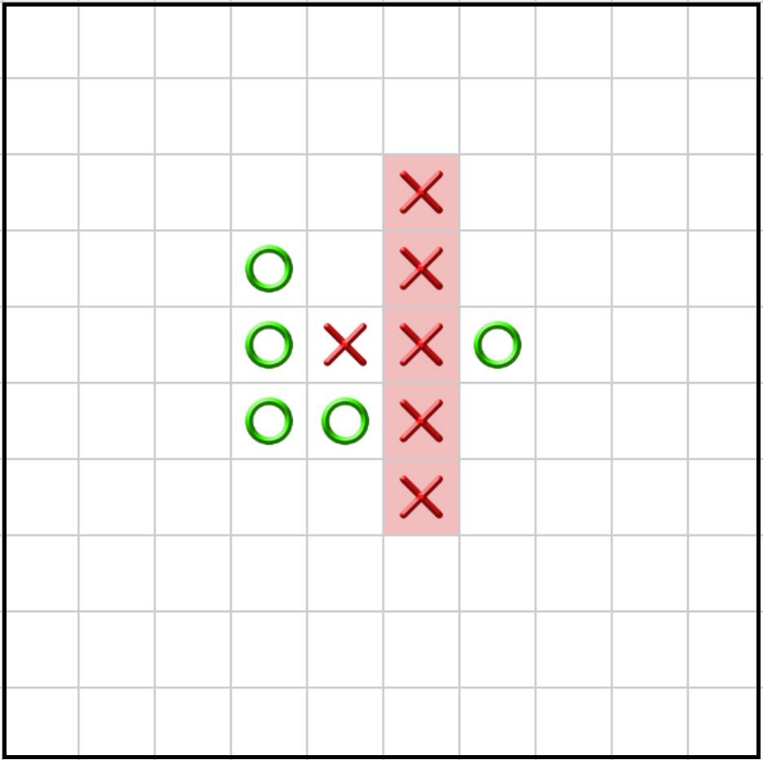
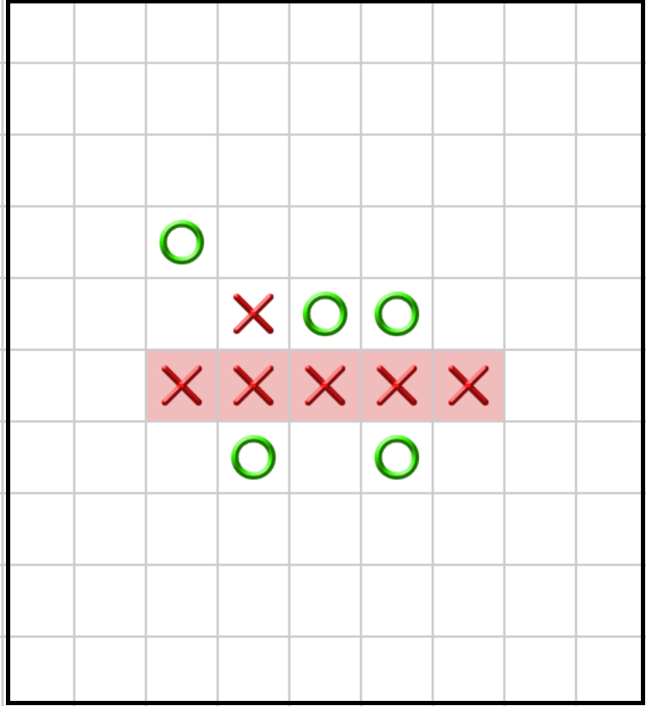
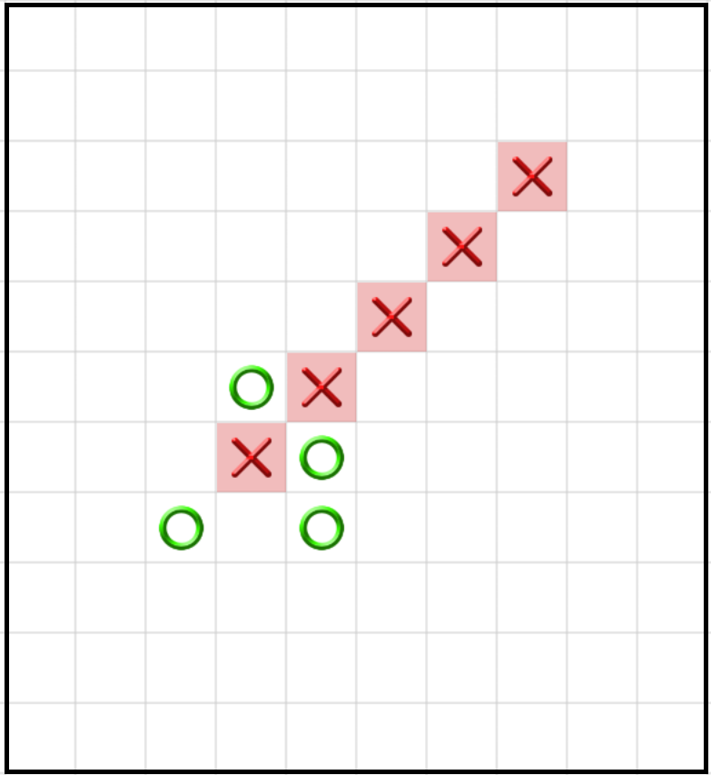
Introduction to Gomoku Game
Standard Gomoku Game
Example: X win

Slide 4
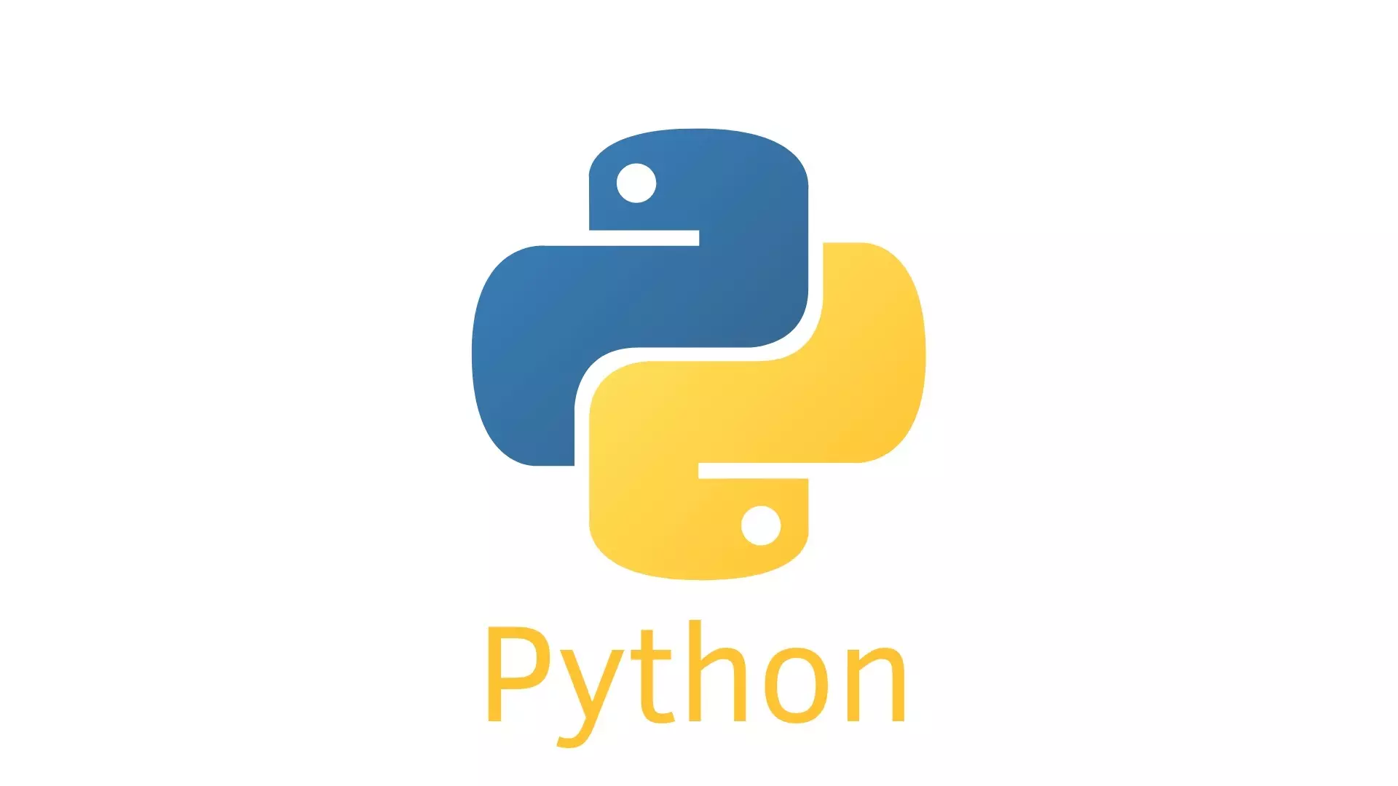


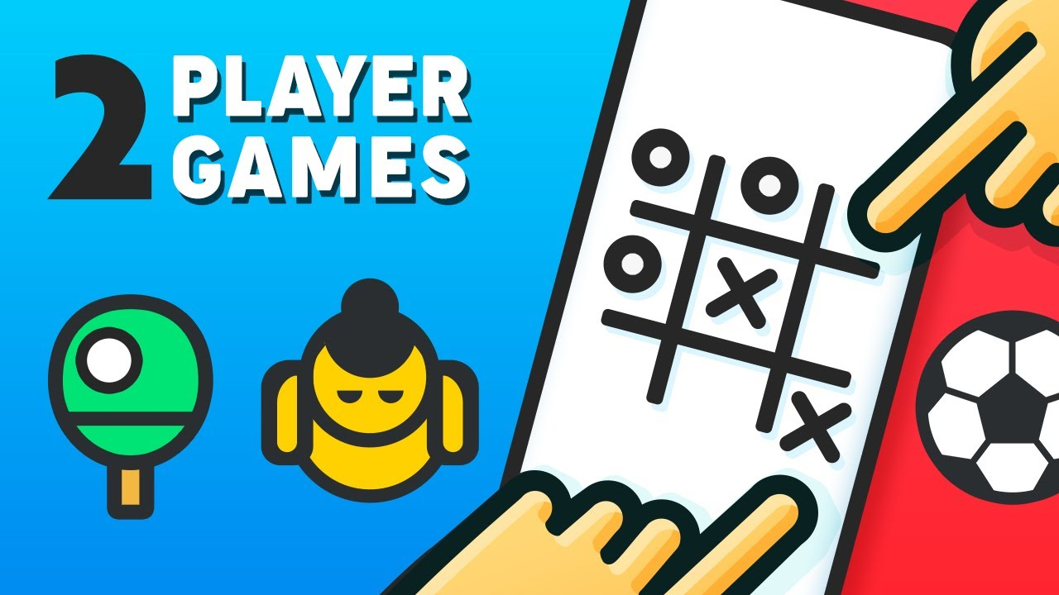

Development Approach
Language: Python
Library for UI: Turtle / tkinter
Main algorithms: Minimax / Alpha-Beta

Slide 5
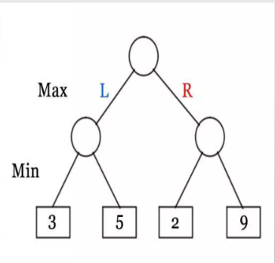
Algorithms / Minimax
MAX : MAX plays to maximize his score
MIN : MIN plays to minimize his opponent’s score

Slide 6
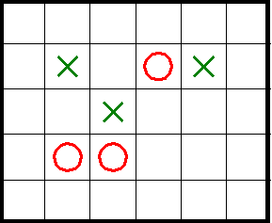
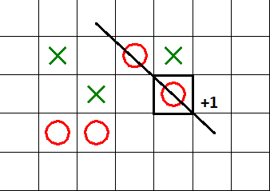
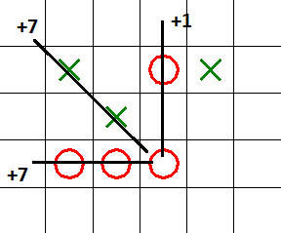
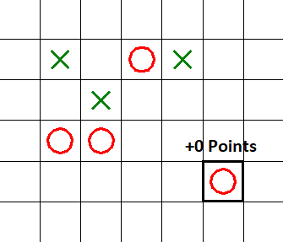
(Easy mode)
Depth=1
✗ 1 points
✓15 points
✗ 0 points

Slide 7
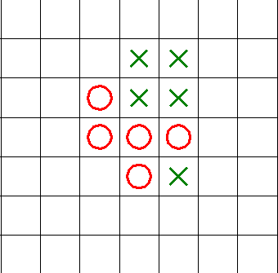
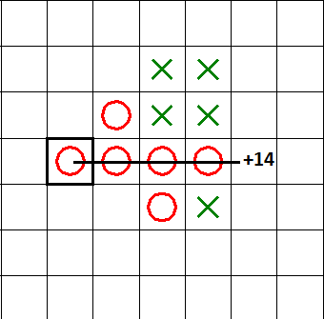
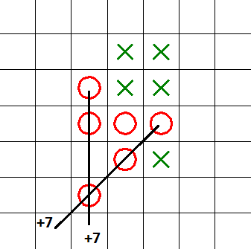
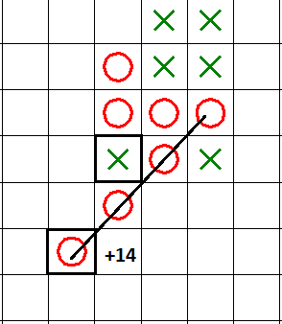
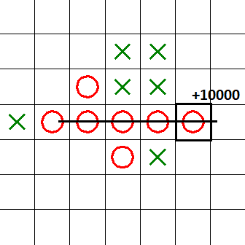
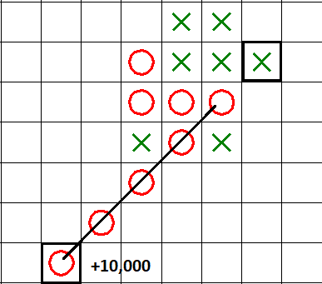
Same point(hard mode)
Depth = 1
Depth = 1
= 14 points
= 14 points
Depth = 2
Depth = 2
Depth = 3
✗ Win slower
✓ Win faster

Slide 8
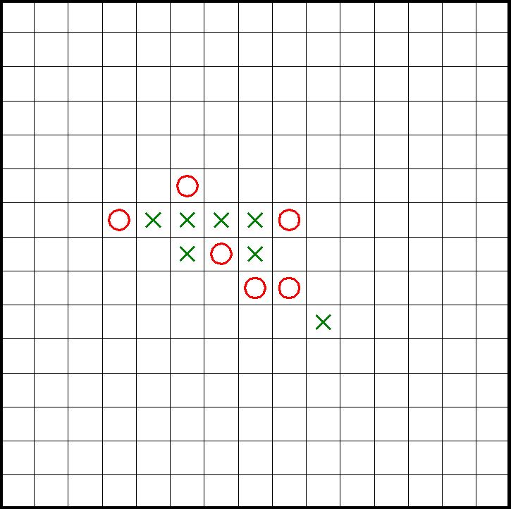
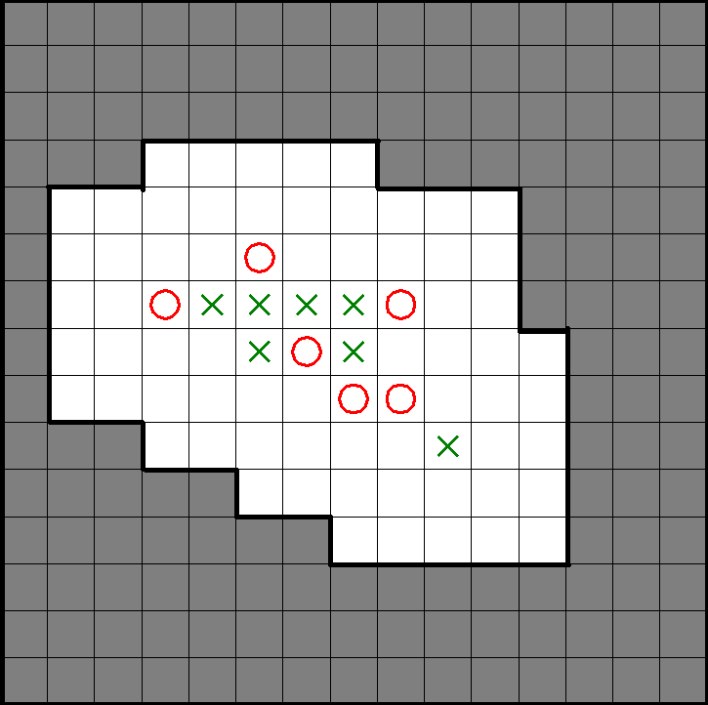
Algorithms / Heuristics / Reduce space
Ignore gray region => faster

Slide 9
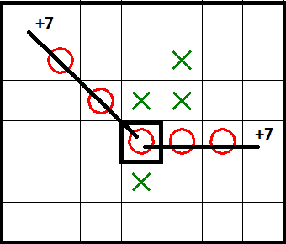
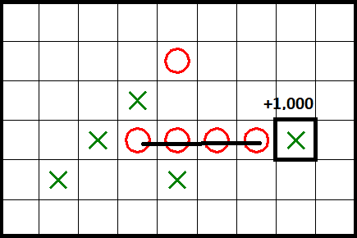
Algorithms / Heuristics / Calculate point
All 4 directions:
Point = 7 + 7 = 14
Prevent opponent to win:
Point = 1,000

Slide 10
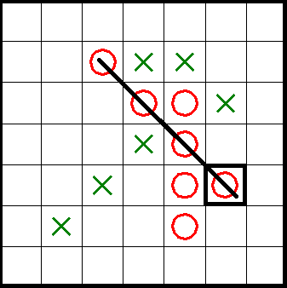
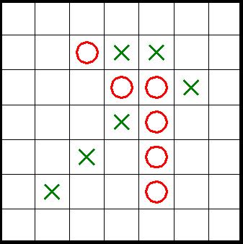
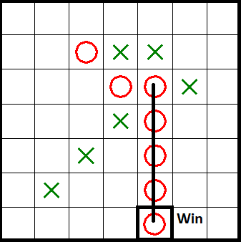
Algorithms / Heuristics / Calculate point
Point = 1,000 => lower point
Point = 10,000 => higher point

Slide 11
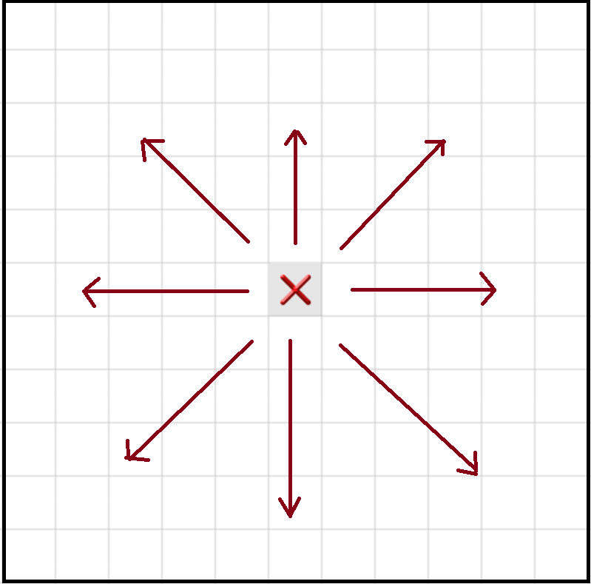
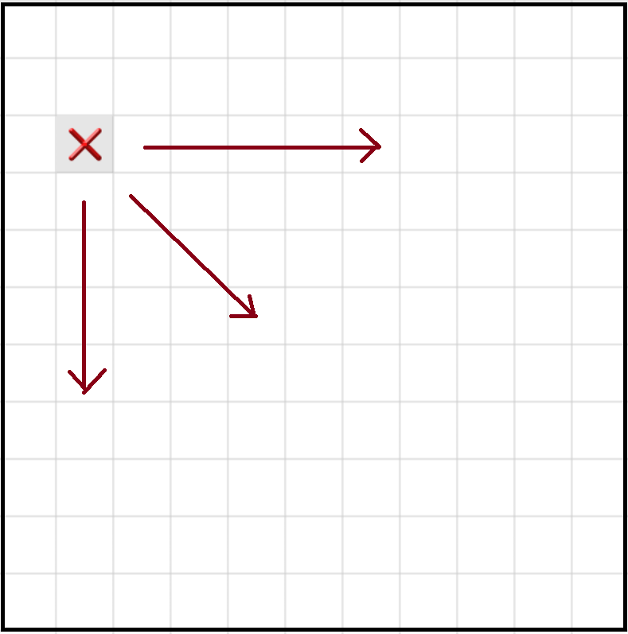
Algorithms / Heuristics / First move
✓Higher point
✗ Lower point

Slide 12
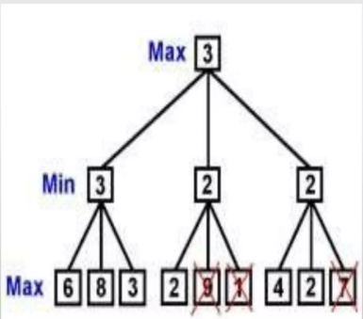
Algorithms / Alpha-Beta pruning
If a search branch cannot improve on the utility function value we already have, then that branch is not considered.

Slide 13
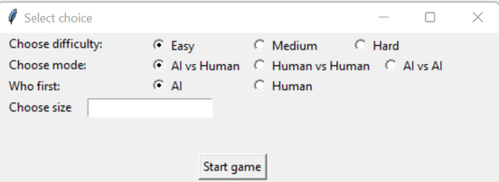
Functionalities

Slide 14
Demo

Slide 15



Thank you <3

Slide 16
Summary
Achievements:
Completed UI
Completed algorithm
Difficulty:
Shortage of time
Shortage of skills

Slide 17
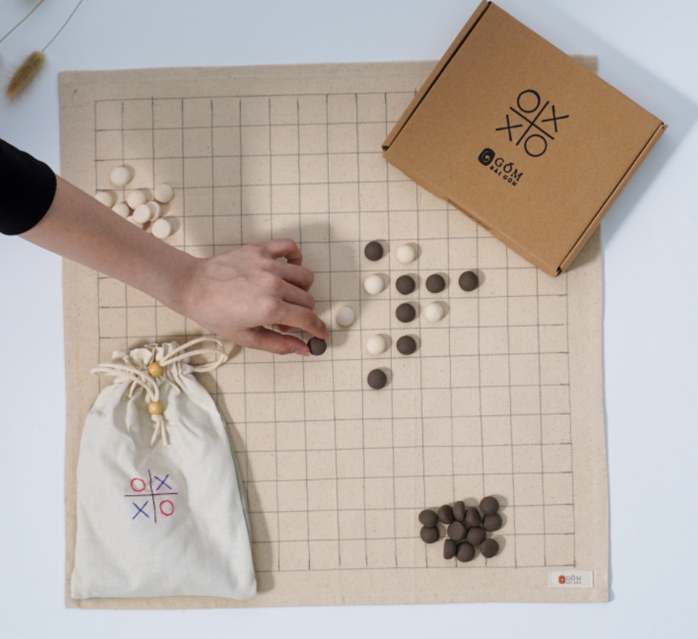
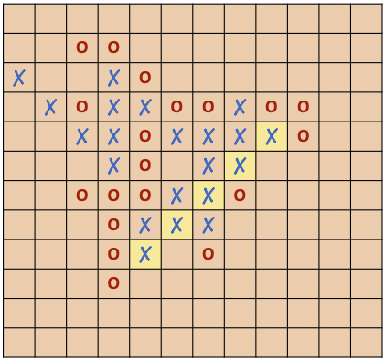
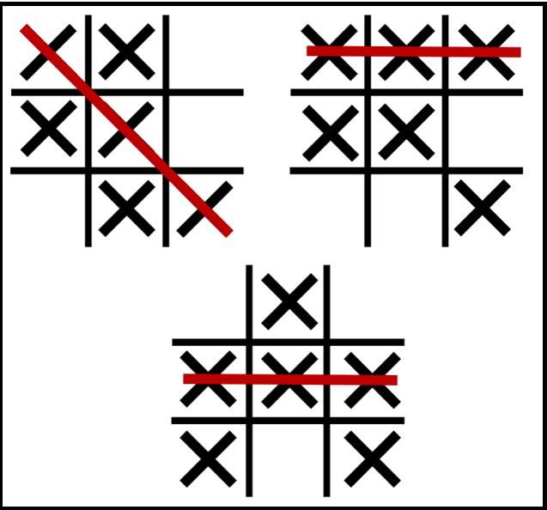
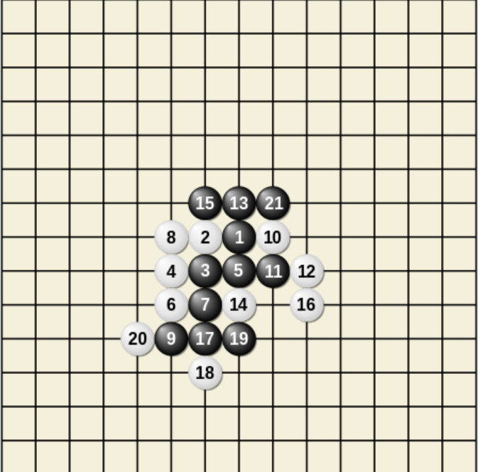
Introduction to Gomoku Game

